Slide 1
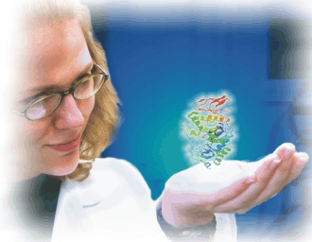
Protein Production and Purification
“Why the medium composition counts."

Slide 2
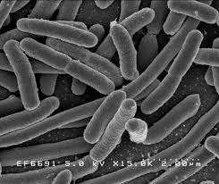
The E. coli System
Advantages:
Well developed science and tools with a 40 year history of successes
Inexpensive
Short development timelines
Low cost production systems
Disadvantages:
Endotoxin contamination
Heterologous proteins often accumulate as insoluble products in cytoplasm – “Inclusion bodies”
Export to periplasm is possible but rare for secretion to the medium
No post-translational glycosylation
Inexpensive tools

Slide 3
Variables in Protein Production
Gene
Vector
Host
Production
Codon Usage
mRNA Structure
GC Content
Regulatory Motifs
Repeats
Replication Origin
Promoters
Ribosome Binding
Regulatory Elements
Terminators
Drug Resistance
Protease Deficiency
Redox Environment
Recombination
Polymerases
Chaperonins
Temperature
Carbon Source
Nitrogen Source
Micro-nutrients
Aeration
pH
Metabolic Waste
Adapted from Gustafsson et al 2012. Protein Expression and Purification. 83:37-46.

Slide 4
Variables in Protein Purification
Extraction
Purification
Stabilization
Intra- or Extracellular
Host contaminants
Process contaminants
Physical-chemical properties
Specifications
Protein stability
Protein-protein interactions
Means of measuring
Host contaminants
Degradation pathways
Trace inhibitors
Empirical science
Highly interconnected
Choice of host-vector system
Type of extraction process
Post-translational modifications

Slide 5
E. coli Expression Vectors
Inducible, cytoplasmic accumulation
Lac Operon: promoters, T7, T5, tac, trc, lacP
Arabinose Operon
Tryptophan Operon
Lambda Repressor
With Affinity Tags
His, MalE, GST, Trx, Flag, and others
Periplasmic Expression
Signal Sequences: OmpA, PelB, SpA, PhoA, and others

Slide 6
The History of LB Broths
Originally developed in the 1950’s to cultivate E. coli.
Comes in three variations
Miller, Lennox and Luria
Differ in NaCl content: 10, 5 and 0.5 g/L, respectively
Period in time when optimum growth conditions were not known.
Long before recombinant proteins were produced in E. coli.
And they worked for the physiological and genetic experiments of the time.
However, ….

Slide 7
The LB Broths
Have no added carbon source.
Are not buffered.
No added phosphate, sulfate, or potassium
Composition of LB Broths
Yeast Extract | 5 g/L
Casein Hydrolysate | 10 g/L
NaCl | 10 g/L (Miller) 5 g/L (Lennox) 0.5 g/L (Luria)
Not designed or intended for production of recombinant proteins.

Slide 8
Better Media Formulations
Biomass yield of E. coli grown in six different medium.
Medium | Biomass Yield (g/L)
LB (Miller) Broth | 10
Glucose M9Y | 16
Hyper Broth™ | 36
Power Broth™ | 24
Superior Broth™ | 18
Turbo Broth™ | 30
E. coli strain JM109 was grown in 100 ml shake-flask cultures in each medium at 37ºC for 16 h.
Not all proteins express well in E. coli.
20 years of helping clients overcome this limitation.
Discovered that the carbon and nitrogen source can make a big difference.

Slide 9
Medium Composition Makes a Difference
None
MalE
GST
GFP
I27O
TesA
LypA
Figure. SDS-PAGE analysis of total protein from each strain in Table 1. Samples were prepared as described in the Materials and Methods section. Panel A - reference strain without a recombinant protein; Panel B to G - MalE, GST, GFP, I278, TesA, LypA, respectively. Arrows denote the location of the respective protein. Marker proteins are shown to the left and right of each set of cellular proteins. From left to right in each panel are samples from cells grown in LB (Miller), Glucose M9Y, Hyper Broth™, Power Broth™, Superior Broth™ and Turbo Broth™.

Slide 10
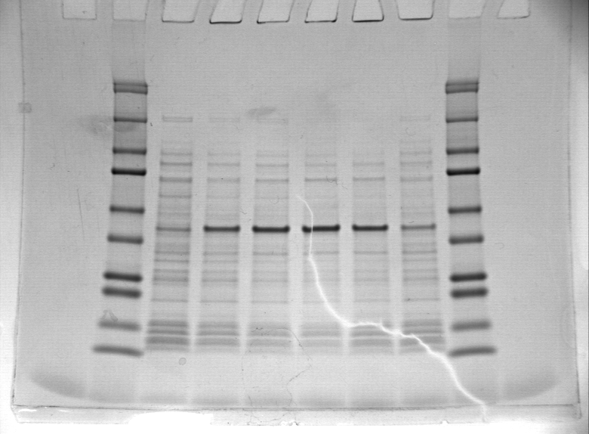
Medium Composition Makes a Difference
Mammalian protein produced in a 400 liter fementor
Lane 1 = MW marker
Lane 2 = Un-induced fermentor
Lane 3 = Fermentor harvest, IPTG
Lane 4 = UGA's Auto-induction
Lane 5 = Hyper Broth auto-induction
Lane 6 = Power Prime auto-induction
Lane 7 = Overnight Express™ auto-ind.
Lane 8 = MW marker.
MP8
Overnight Express™ Autoinduction Medium is a trademark of EMDMillipore.

Slide 11
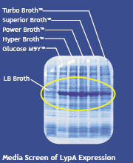
Not Just More Protein, But More Active Protein
Expression of TesA and LypA
3 x 10⁵
Isogenic Parent
TesA
LypA
2 x 10⁵
Specific Activity
(moles/min/mg)
1 x 10⁵
0
Glucose M9Y
LB Broth
Hyper Broth
Power Broth
Superior Broth
Turbo Broth

Slide 12
Recommendations
Richer media formulations will yield more recombinant protein than LB Broths.
The best medium to produce a protein in a given host-vector system should be empirically determined.
A simple screen will make all the difference.

Slide 13
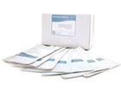
Where to Buy
Screening Kits are available through Molecular Dimensions.
Visit www.moleculardimensions.com
Look under “Protein Expression Media”
Media Optimization Kit
Available in standard and animal product free versions.

Slide 14
References
Strobel, R. J. and Sullivan, G. R. 1999. Experimental design for improvement of fermentations. In Manual of Industrial Microbiology and Biotechnology, 2nd Ed., eds., Demain, A. L. and Davies, J. E. ASM Press, Washington, DC, pg 80-93.
Lee, S. Y. 1996. High Cell-density culture of Escherichia coli. Tibtech 14:98-10S.
Kleman, G. L. and W. R. Strohl. 1994. Development in high cell density and high productivity microbial fermentation. Current Opinion in Biotech. S:180-186.
Broedel, S. E., Papciak, S. M. and Jones, W. R. 2001. The Selection of Optimum Media Formulations for Improved Expression of Recombinant Proteins In E. coli. Athena Technical Bulletin, http://www.athenaes.com/tech_brief_optimum_media.php
Luria, S. E. and J. W. Burrous. 1955. Hybridization between Escherichia coli and Shigella. J. Bacteriol. 74:461-476.
Lennox, E. S. 1955. Transduction of linked genetic characters of the host by bacteriophage P1. Virology. 1:190-206.
Luria, S. E., J. N. Adams, and R. C. ting. 1960. Transduction of lactose-utilizing ability among strains of E. coli and S. dysenteriae and the properties of the transducing phage particles. Virology. 12:348-390.
Miller, 1972. Experiments in Molecular Genetics. Cold Spring Harbor Laboratory. Cold Spring Harbor, NY.

